Slide 1
CS 4350: Fundamentals of Software Engineering Lesson 5.1 Introduction to Testing and TDD
Jonathan Bell, Adeel Bhutta, Ferdinand Vesely, Mitch Wand
Khoury College of Computer Sciences
© 2022 Released under the CC BY-SA license

Slide 2
Learning Objectives for this Lesson
By the end of this lesson, you should be able to:
Describe the elements of a test and how they are used;
State Dijkstra’s law and its relevance;
Classify tests by purpose, scope and size;
Explain why test automation is important.
Understand how “Test-Driven Development” is related to testing;
Contrast two different phases for programming in TDD;
Outline the strengths and weaknesses of TDD.
Notes:
<read slide>

Slide 3
Working Definition
Software Testing is the process of checking if software meets certain concrete requirements
“certain” – a finite set
“concrete” – particular, not symbolic
Testing is carried out by execution of the software.
Next: definitions “SUT” and “Test”
Notes:
Let's start with the working definition of software testing. Testing is a process of checking to see if the software that you have developed meets certain concrete requirements. Two things that are important here. (1) Certain i.e., these are a finite number of things that we are talking about (requirements, features) and (2) they are concrete, they are not symbolic i.e., you can see them, you can observe them. So testing is carried out by running the software, by executing the software. So let’s first define some of the related terminology.

Slide 4
SUT = System Under Test
The “System Under Test” consists of its
Inputs
State
Outputs
State Change
(Other) Behavior
System
State
State Change
Inputs
Outputs
Behavior
Notes:
SUT is system under test. ‘System under test’ basically means that your software or whatever software and hardware combination i.e., system you have built, you can provide an input. That input will go through your system and produce an output. System can have its own state and it can have other behaviors.

Slide 5
Running a Test
Construct the situation:
Set up SUT to get the state ready
[Optional: Prepare collaborators]
Apply the operation inputs.
Check the outputs, verify the state change, handle the behavior
Handle exceptions,
Time-Out to handle nontermination,
Post-check with collaborators.
Notes:
So, a test basically can come in many forms, test could be given in the form of an input and your system will then respond or change the state and produce an output. When we talk about running a test, we set up our ‘system under test’ to get the state ready, and we apply the inputs and then we observe the output, and we observe the state of the system. We look at the behavior of the system.

Slide 6

Dijkstra’s Law
“Program testing can be used to show the presence of bugs, but never to show their absence!” – Edsger Dijkstra
The state space of a SUT is (usually) infinite, but testing can only execute a finite number of tests.
Even if the state space is finite, it may still be too large to make exhaustive testing feasible.
And this ignores the fallibility of tests. What if the tests are in error?
Notes:
There is a famous Dykstra's law which basically states that when you are testing your program, testing can be used to show the presence of bugs but it can never show the absence of those bugs. This comes from the fact that you cannot spend all your life on testing, you only have a finite amount of time for you to be able to test the program. So, every time you are going to provide a certain input to the system you are going to observe its behavior, and you only can do it a limited number of times. So that's why you can't run infinite tests.

Slide 7
Classifying Tests
We can classify tests according to several cross-cutting dimensions:
Scope: What sort of thing is the SUT?
Purpose: Why are we testing?
Size: What resources does testing need?
How: How is testing performed?
Notes:
<read slide>

Slide 8
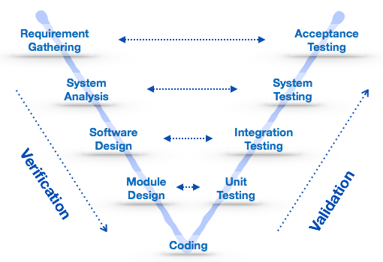
Test Scope
Unit tests: SUT = a single method/class/object
Integration tests: SUT = combinations of units, a subsystem
System tests: SUT = whole system being developed
Verification: "Are we building the product right?"
Validation: "Are we building the right product?"
Notes:
The scope of the test can't be can be represented in many different ways. For example, when we talk about unit tests, we talk about tests that are either focused on a particular function or a method or a procedure, or sometimes when you are testing a class, then you can call it a unit test, or sometimes you look at objects or a group of classes and that is your system under the test. When you talk about integration testing, we are basically looking at many subsystems. So we combine many of these units and then test the combination of them. This is often known as integration testing. Then system testing is testing of the entire system, which could be many subcomponents, hardware, software everything together. So, there is a related terminology that is used that which is known as verification and validation, so verification basically means are we building the product right? And validation means are we building the right product. <May be explain different SDLC activities and how they are related to V&V>

Slide 9


Test Purpose
Acceptance Test
Customer-level requirement testing
Validation: Are we building the right system ?
Functional Test
“Black-Box” testing
Specification Testing
Structural Test
“White-Box” testing
Exercising the code
Regression Test
Prevent bugs from (re-)entering during maintenance.
Functional “black box”
Structural “white box”
Notes:
Another way to classify test is by looking at their purpose: Functional tests are often known as black box testing where you are not looking at the source code. It is a black box and you just have API. You know how to run the code or you're testing functions or behaviors. So you're basically looking at the specification and seeing if the functionality of your system meets those specifications. Structural testing, on the other hand, looks inside the box. It's a white box testing where you are looking at the source code and you're trying to figure out if everything looks right. Regression testing relates to preventing bugs from reappearing in your system when you make changes
<read slide>

Slide 10
Test Size
We begin by ‘testing-in-the-small’ and move toward ‘testing-in-the-large’
Small: run on a single process, no blocking I/O
Fast to run; can be run automatically and frequently
Medium: run on a single machine, no network I/O (only localhost); “hermetic”
May be slower; delayed to overnight runs
Large/Enormous tests: run on a network.
May have serious $$$ cost in network services or personnel.
See SoftEng @ Google Chapter 11
https://learning.oreilly.com/library/view/software-engineering-at/9781492082781/ch11.html#testing_overview
Notes:
<read slide and mention the book>
In practice when you are testing, we often begin testing in small and then we move towards testing in the large. What that basically means is that we start testing the modules/functions, the classes that we are writing, and then slowly, slowly, we get to the integration testing and then we get to the system testing and so on. So testing starts small and then you move outwards to testing the overall system.

Slide 11
Manner of Testing
Automated tests can be run without supervision
Suitable for frequent automated runs
Manual tests require a human to run and evaluate
A human may be needed to check UI elements
Tests may be ill-defined and nondeterministic
e.g., trying to “break” software
Customer-facing tests require an intermediary to evaluate as well as the customer to use the software.
Notes:
<read slide>

Slide 12
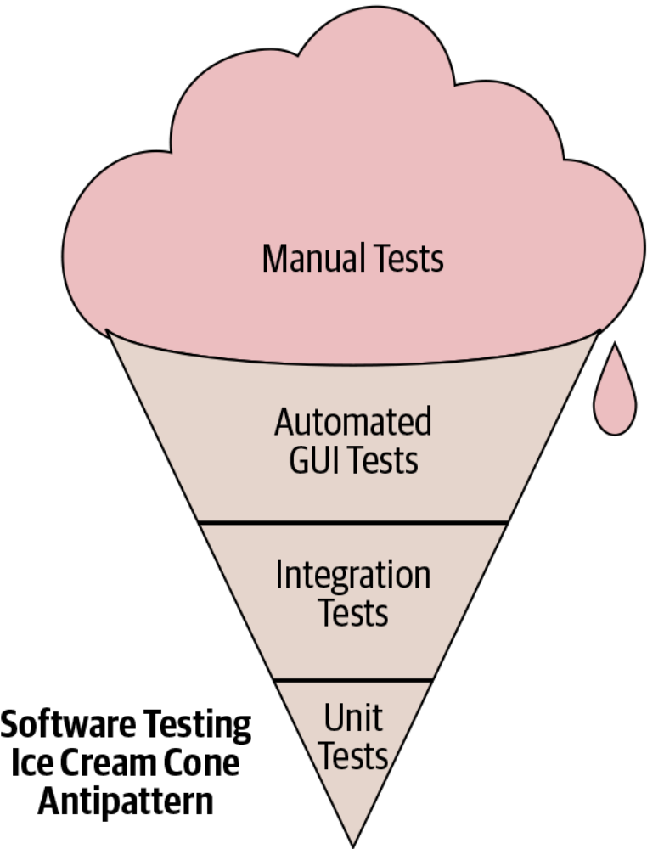
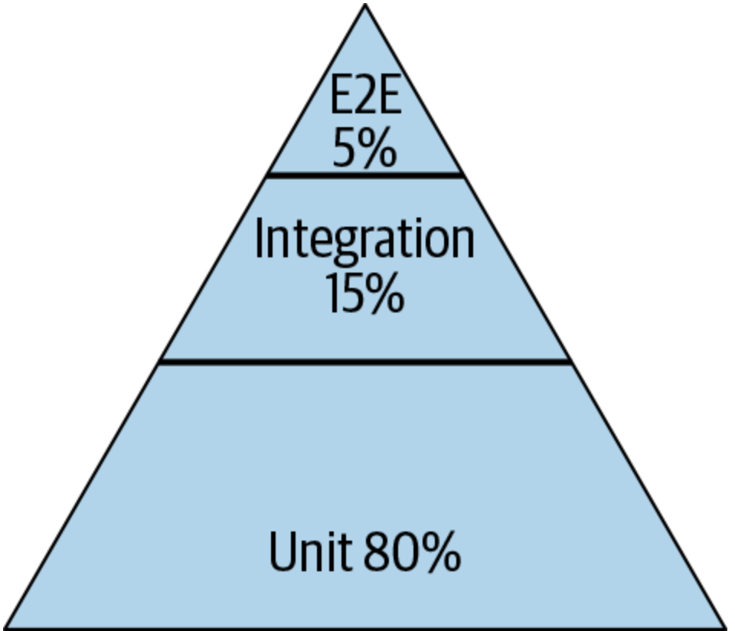
Test Distribution (Size/Scope/Manner)
Pyramid
Test Pattern
From SoftEng @ Google Chapter 11
https://learning.oreilly.com/library/view/software-engineering-at/9781492082781/ch11.html#testing_overview
Notes:
Typically we talk about this ice cream cone where we have a lot of a lot of manual tests, and then some automatic automated tests specifically related to GUI and then some integration tests and unit tests. The book that we mentioned earlier, software engineering at Google, recommends a different paradigm. It recommends that about 80% of your testing should be focused on unit testing and then about 15% on integration testing and then about 5% on end to end testing (what is known as system level testing).

Slide 13
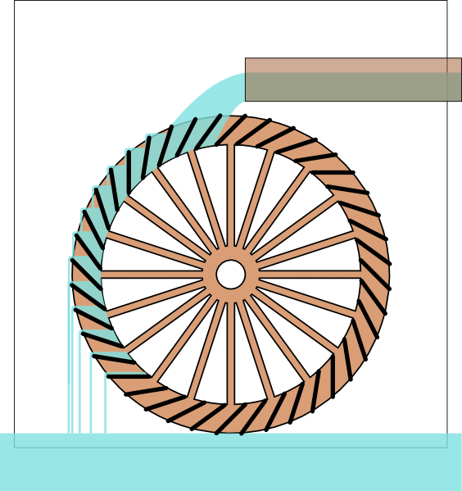
Test-Driven Development (1)
From outside, the development is driven by “issues”:
New feature requests;
Enhancement requests;
Bug reports;
Internal feature requests.
Issues are the “water” in our “TDD = water wheel” metaphor.
Issues
Notes:
Let’s also say a word about TDD and how it related to testing When we talk about TDD from the outside, it's always driven by issues. So the issues could be that we have new features, new requests, or we have bugs that we have to fix or some other request that we have to fulfill. Looking at our analogy, we have this water wheel and water is dropped on the wheel which makes it turn. So the issues, which could be bug reports, feature requests or enhancement requests, are the water in this analogy.

Slide 14
Test-Driven Development (2)
The first task is to write a test.
The test should fail.
A bug report is not actionable until we have replicated it.
A feature request is not actionable until we know what how it should work.
Tests are the “buckets” in our metaphor.
Issues
Write test
Notes:
<read slide>

Slide 15
Test-Driven Development (3)
Then we fix the code:
Change code until test passes;
All previous tests must pass too (no regression!);
No redesigns; goal is to fix as quickly as possible.
Coding turns the wheel until the “water” is gone (issue is fixed).
Issues
Write test
Fix code
Notes:
<read slide>

Slide 16
Test-Driven Development (4)
Clean up code:
At leisure, “refactor” code;
Not driven by issues;
No (visible) behavior changes;
All tests must still pass;
Improve maintainability.
Refactoring borrows momentum to turn the wheel without the action of “water.”
Issues
Write test
Refactor
code
Refactoring
Fix code
Notes:
<read slide>

Slide 17
Caveats & Qualifications
Typically, a new feature will require multiple tests
The “fix” should not just be the minimum to pass the test(s)
The programmer should keep in mind the spec/requirements.
But the fix should be the simplest possible that addresses the issue.
Tests are run frequently and thus must be fast and deterministic.
Occasionally, the tests may need to be fixed as well.
Notes:
<read slide>

Slide 18
Strengths
Goals are concrete and actionable.
We revisit requirements frequently:
We make sure we are building the right product;
Mistakes are fixed earlier.
Separate refactoring stage means code hygiene is not forgotten.
Test portfolio gives confidence in maintenance.
Notes:
<read slide>

Slide 19
Weaknesses
Often the same person writes the test and implements the code being tested
Blind spots: programmer may overlook something;
Gentleness: programmer may avoid “hard” tests.
Tests can add to maintenance problems
Slow, flaky or brittle tests can slow down ”wheel” (both fixing code and refactoring)
As defined, TDD is perhaps overly strict. (Discuss!)
Notes:
<read slide>

Slide 20
Review
Now that you've studied this lesson, you should be able to:
Describe the elements of a test and how they are used;
State Dijkstra’s law and its relevance;
Classify tests by purpose, scope and size;
Explain why test automation is important.
Understand how “Test-Driven Development” is related to testing;
Contrast two different phases for programming in TDD;
Outline the strengths and weaknesses of TDD.
Notes:
<read slide>

